Slide 1
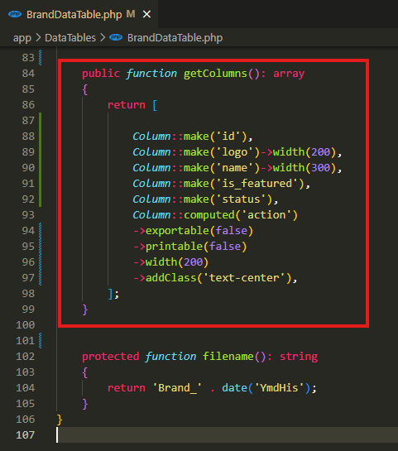
app\DataTables\BrandDataTable.php

Slide 2
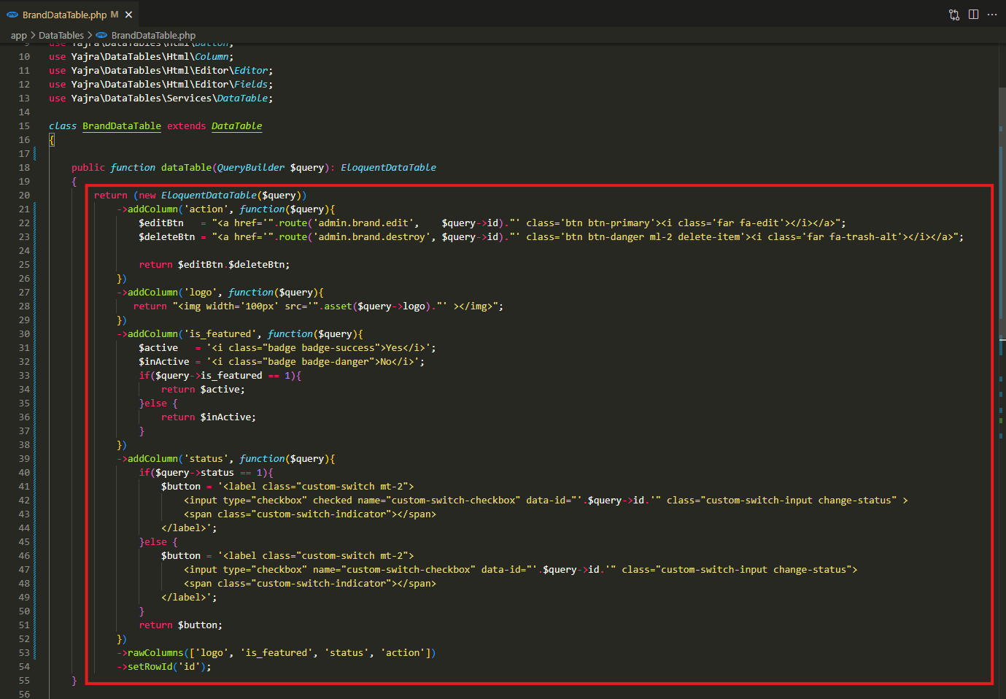
app\DataTables\BrandDataTable.php

Slide 3
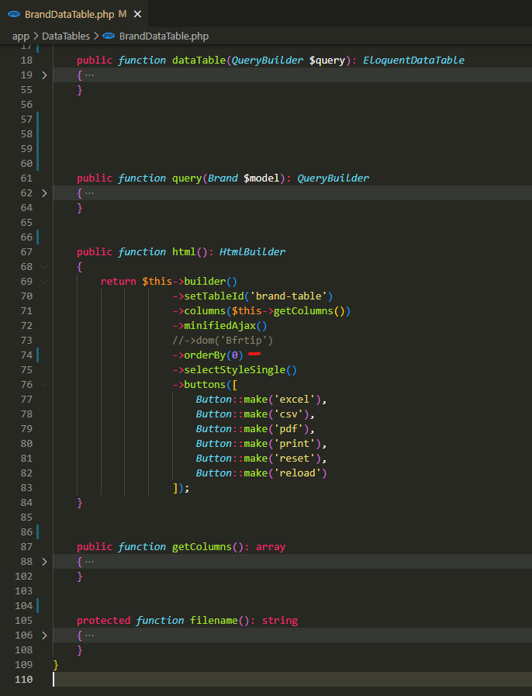
app\DataTables\BrandDataTable.php

Slide 4
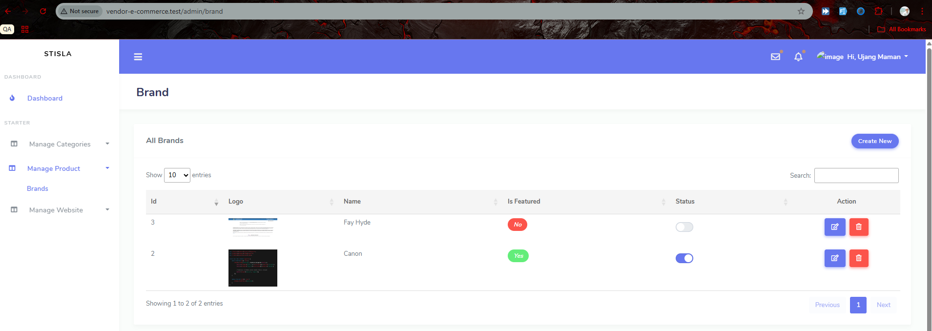
.

Slide 5
.

Slide 6
.

Slide 7
.

Slide 8
.

